Slide 1
Kolmogorov-Arnold Networks
Mehmet Ali Aytekin

Slide 2
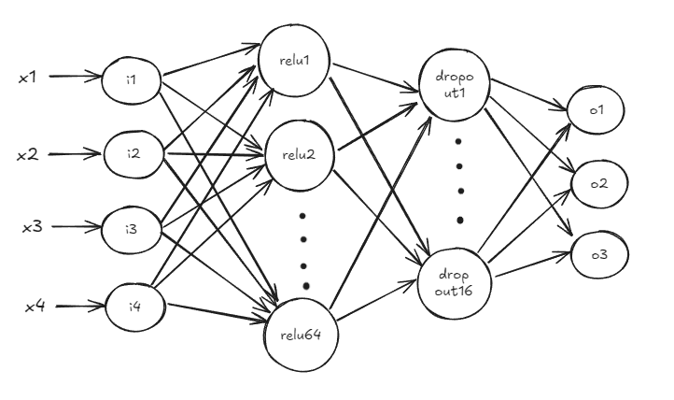
Traditional Neural Networks

Slide 3
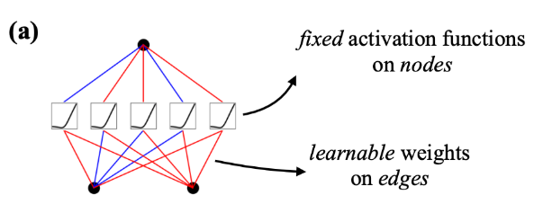
Traditional Neural Networks
Fixed activation functions on nodes
Learnable weights on edges
All neurons have a fixed activation function

Slide 4
Traditional Neural Networks
Complex and not suitable for interpretation
Black box
Second-layer neurons learn patterns from first-layer, and so on..

Slide 5
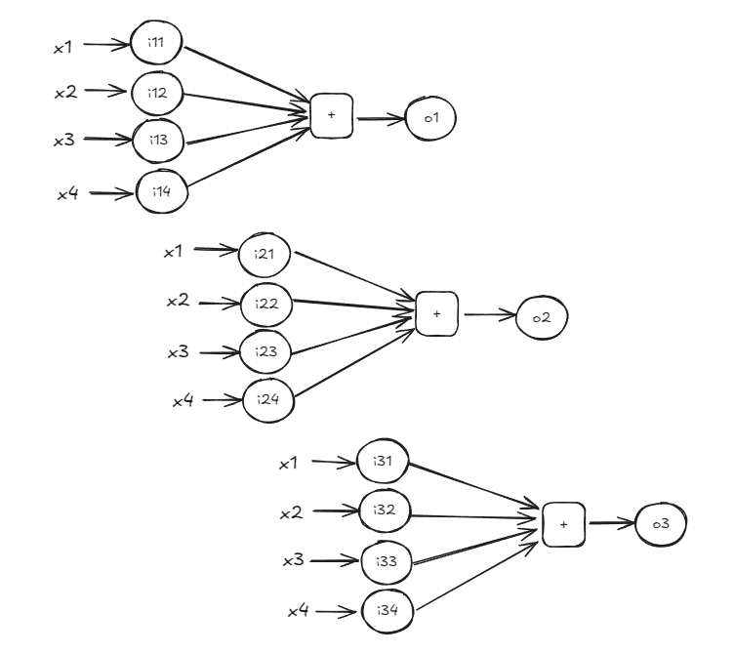
Kolmogrov-Arnold Networks

Slide 6
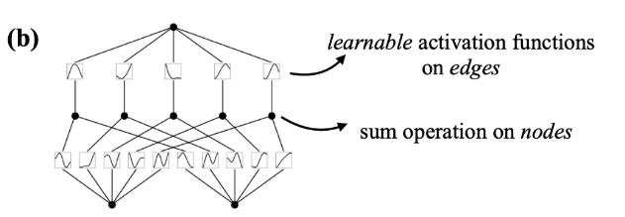
Kolmogrov-Arnold Networks
Learnable activation functions on edges
Sum operation on nodes
Every edge has a different activation function

Slide 7
Kolmogrov-Arnold Networks
Key points for design and implementation:
One hidden layer
Suitable for any continuous function
Activation function must be non-linear (sigmoid,ReLU)
Our task in KAN, to find a sum of simple single-variable functions that represents a multivariable function

Slide 8

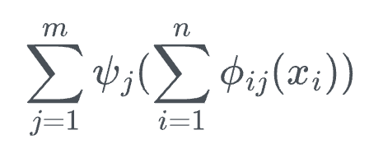
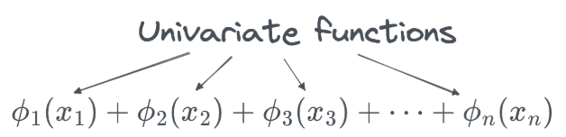
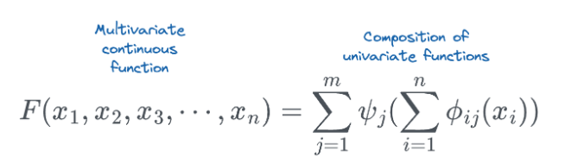
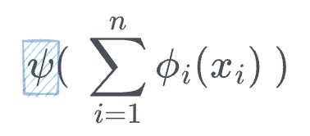
Kolmogrov-Arnold Networks

Slide 9
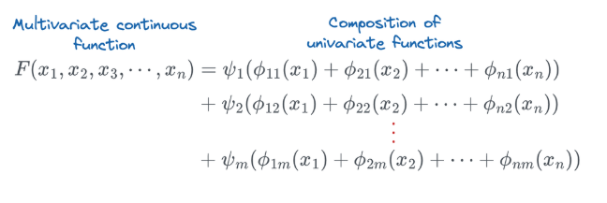
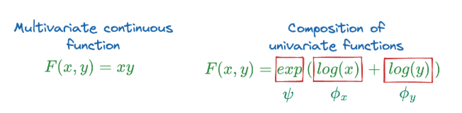
Kolmogrov-Arnold Networks

Slide 10
Differences
Edges
MLP has one weight
KAN has a function
Layer
MLP can have much layers
KAN doesn’t require much large layers
Performance
KAN has lower test loss, but slower than MLP when they have the same number of params
Continual Learning
MLP will soon forget about how to perform prior tasks
KAN adapts to new data well

Slide 11
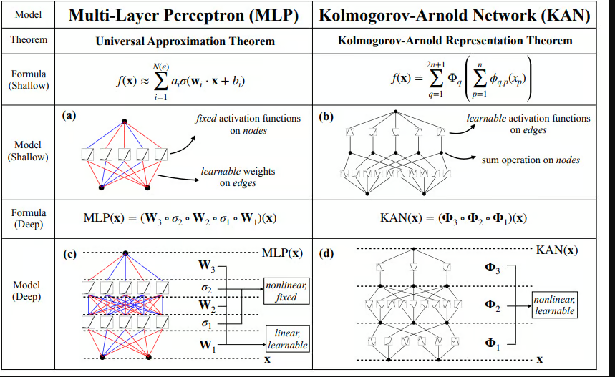
Differences

Slide 12
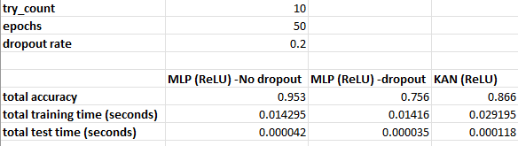
Development and Test Results

Slide 13
Resources
https://www.dailydoseofds.com/a-beginner-friendly-introduction-to-kolmogorov-arnold-networks-kan/
https://arxiv.org/pdf/2404.19756
https://medium.com/@saitejamummadi/creating-a-simple-neural-network-to-classify-iris-species-using-pytorch-45586f45c9e1

